Slide 1
Joins

Slide 2
Joins
One of the most essential tools while working with DBs
A JOIN clause in SQL – corresponding to a join operation in relational algebra – combines columns from one or more tables into a new table. You specify what columns (or all of them) you want to have in a result.
This new table can be treated as a result set or used further in calculations.
Typically you join tables by specific field(s)
You can join quite many tables in one query, some RDMBs have limit

Slide 3
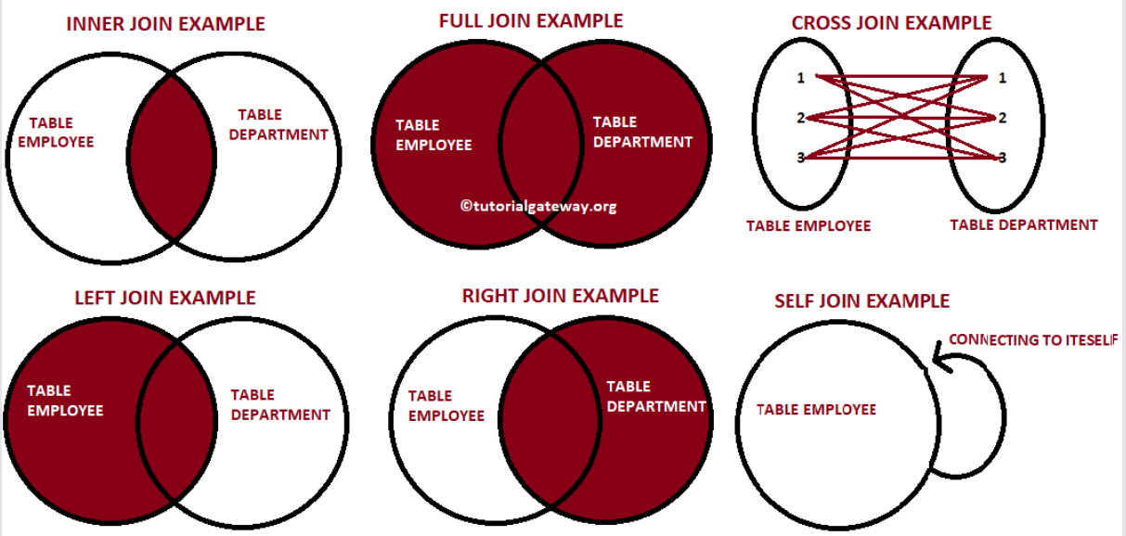
Joins: general syntax
SELECT t1.field1, t2.field2
FROM table1 [AS] t1
<join type> JOIN table2 [AS] t2 ON <join_condition>
Join condition can be various: (un)equality of column(s), (un)equality of fields to specific values etc.
Join types:
[INNER] JOIN
LEFT/RIGHT [OUTER] JOIN
FULL [OUTER] JOIN
CROSS JOIN

Slide 4
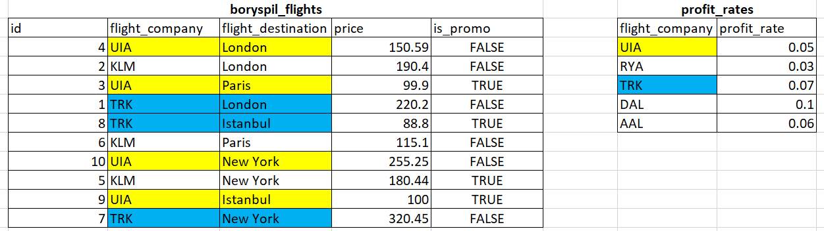
Join: practical example
Let’s use public.boryspil_flights table we created last lesson and add another one:
create table if not exists public.profit_rates
(flight_company text primary key, profit_rate numeric (4,2));
insert into public.profit_rates (flight_company,profit_rate) values
('UIA', 0.05), ('RYA', 0.03), ('TRK', 0.07), ('DAL', 0.1), ('AAL', 0.06);

Slide 5
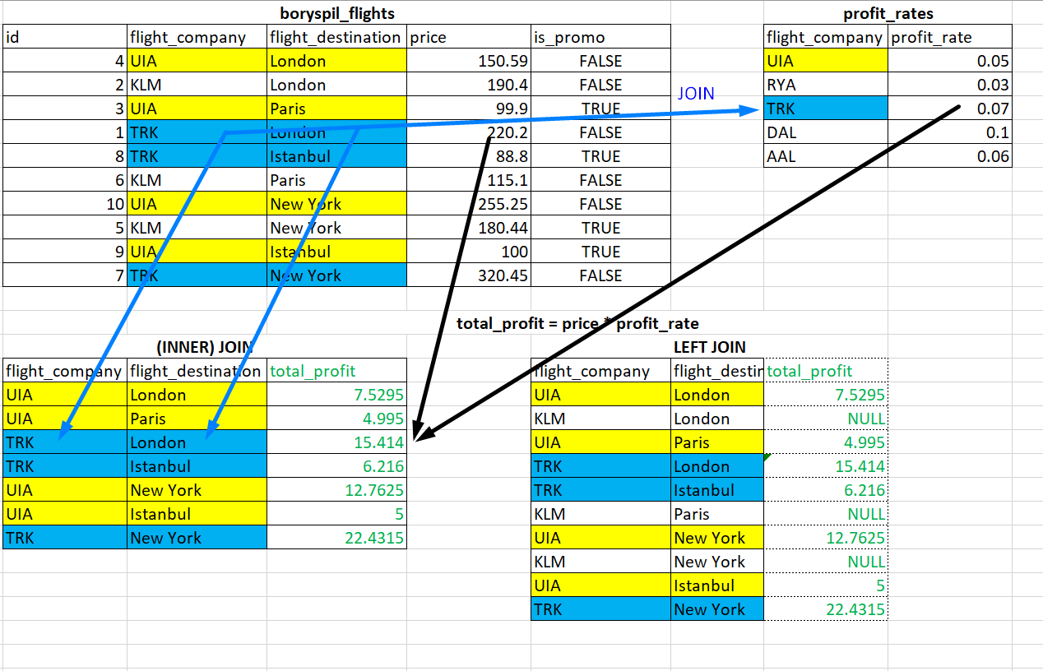
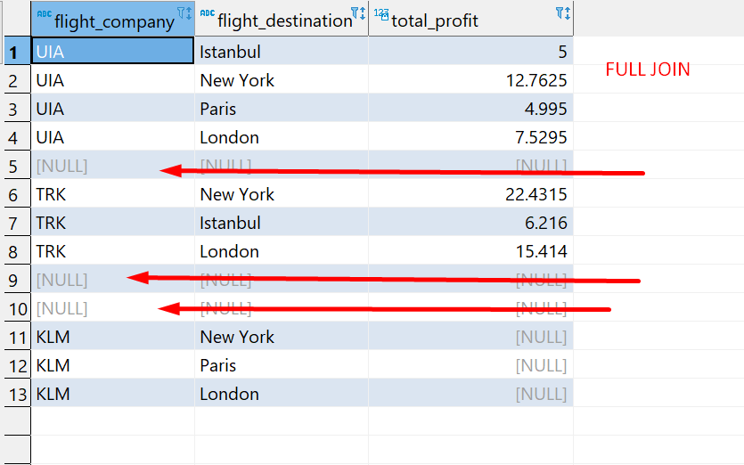
Joins: practical example
INNER JOIN:
select bf.flight_company, bf.flight_destination,
(bf.price * pr.profit_rate) as total_profit
from public.boryspil_flights bf
INNER join public.profit_rates pr on bf.flight_company = pr.flight_company;
LEFT JOIN:
select bf.flight_company, bf.flight_destination,
(bf.price * pr.profit_rate) as total_profit
from public.boryspil_flights bf
LEFT join public.profit_rates pr on bf.flight_company = pr.flight_company;
FULL JOIN:
select bf.flight_company, bf.flight_destination,
(bf.price * pr.profit_rate) as total_profit
from public.boryspil_flights bf
FULL join public.profit_rates pr on bf.flight_company = pr.flight_company;

Slide 6
What is NULL?
Null or NULL is a special marker used in Structured Query Language to indicate that a data value does not exist in the database.
NULL doesn’t equal to 0 (zero) or ‘’ (empty string)!
NULL itself doesn’t have data type
Any arithmetic operation with NULL results to NULL (55 + NULL = NULL)
Any comparison to NULL results to UNKNOWN ( 4 > NULL = UNKNOWN)
There’re some built-in functions helping to treat NULLs properly:
Check if value equal to NULL
Change NULL values in output to some specified etc

Slide 7
NULL handling example
COALESCE – SQL standard function to handle NULLs. Specific RDBMs might have their own in addition. COALESCE checks a list of values and returns first not NULL one.
Syntax: COALESCE(val1, val2, ...., val_n)
General usage: COALESCE (field_or_expression_to_check_for_null, constant or table value to replace NULL)
select bf.flight_company, bf.flight_destination,
COALESCE(bf.price * pr.profit_rate, 0) as total_profit
from public.boryspil_flights bf
LEFT join public.profit_rates pr on bf.flight_company = pr.flight_company;

Slide 8
Joins: more practical examples
Let get the list of routes from all LA airports served by Boeing 777-300:
select distinct ft.departure_airport, ft.arrival_airport
from bookings.flights ft -- "central fact table"
join bookings.airports ap on ft.departure_airport = ap.airport_code -- to get city filter/info
join bookings.aircrafts ac on ft.aircraft_code = ac.aircraft_code -- to get aircraft info/filter
where ap.city = 'Los Angeles' and ac.model = 'Boeing 777-300';
Let get the list of destination airports for Fedor Shevchenko for 15 Jul-15 Oct 2016:
select distinct tkt.passenger_name, f.arrival_airport
from bookings.tickets tkt
join bookings.ticket_flights tf on tkt.ticket_no = tf.ticket_no
join bookings.flights f on tf.flight_id = f.flight_id
where tkt.passenger_name = 'FEDOR SHEVCHENKO'
and f.scheduled_departure between '2016-07-15' and '2016-10-15';

Slide 9
Q&A / Homework
Install bookings schema (see part 3 in the instruction )
Output from bookings schema:
1. List of aircraft models departed from Buffalo
2. List of cities in timezone America/New_York served by Boeing 737-300
3. 10 passengers sorted alphabetically who spend less than $200 per at least 1 booking (not flight).
4. Delayed flights (arrival city, aircraft model) from Washington in October 2016
5. Cancelled flights (arrival city, aircraft model) from Chicago
6. Arrival airports for flights, served by aircrafts which range < 3000 km, departed from Miami

Slide 10
Links to read
https://www.geeksforgeeks.org/sql-join-set-1-inner-left-right-and-full-joins/ (or any other article/tutorial you’d google by ‘sql join basics’)
https://www.tutorialspoint.com/sql/sql-null-values.htm
https://www.w3schools.com/sql/sql_null_values.asp
https://edu.postgrespro.ru/bookings.pdf - detailed description of bookings schema (rus)

